Slide 1
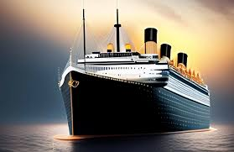
TITANIC
SURVIVAL
PREDICTION
BY :
HARITS MUGHNI ZAKINU

Slide 2
OBJECTIVE
The objective of this analysis is to investigate the factors influencing the survival of Titanic passengers through comprehensive data exploration. Additionally, the goal is to build and evaluate machine learning models to predict passenger survival. Evaluate these models both with and without the application of Synthetic Minority Over-sampling Technique (SMOTE)

Slide 3
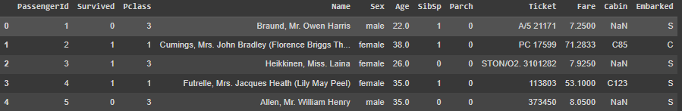
DATA OVERVIEW
The data used is the Titanic - Machine Learning from Disaster Dataset. The data contains 891 rows and 12 columns.

Slide 4
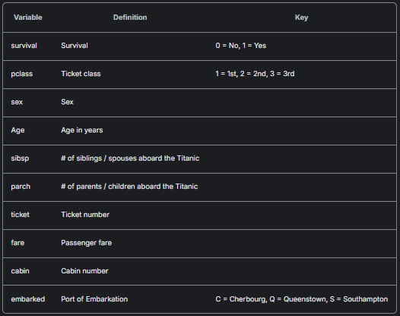
DATA DICTIONARY

Slide 5
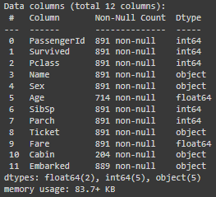
DATAFRAME INFO

Slide 6


DATA CLEANSING

Slide 7
Duplicated Data Check
Fill data in the Age Column with Median
Fill data in the Embarked Column with Mode
Data is ready for EDA
Drop Column Cabin

Slide 8
EXPLORATORY DATA ANALYSIS (UNIVARIATE ANALYSIS)

Slide 9
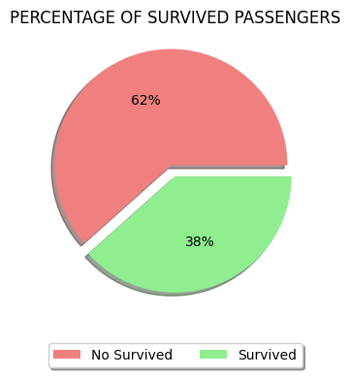
PERCENTAGE SURVIVED PASSENGERS
The data distribution indicates that 62% of passengers did not survive, whereas 38% of passengers did survive.

Slide 10
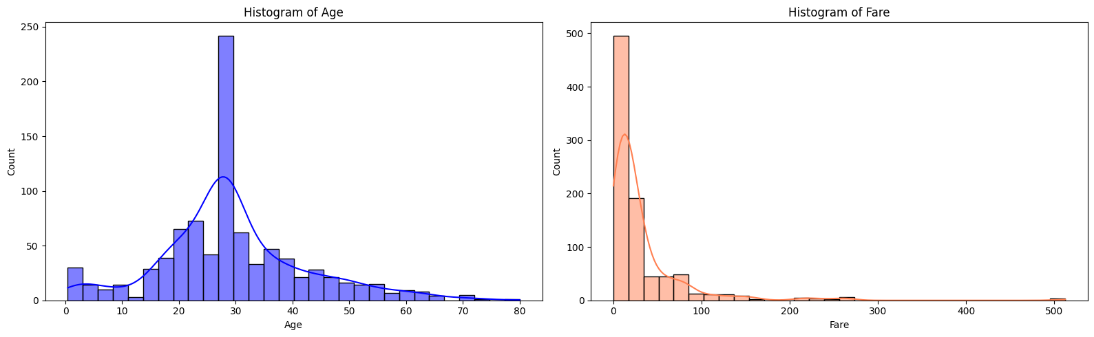
DISTRIBUTION FOR AGE & FARE COLUMNS
Age was normally distributed with a peak around the 30-years.
Fare distribution is heavily right-skewed, indicating that most passengers paid lower fares, with a few paying substantially higher amounts.

Slide 11
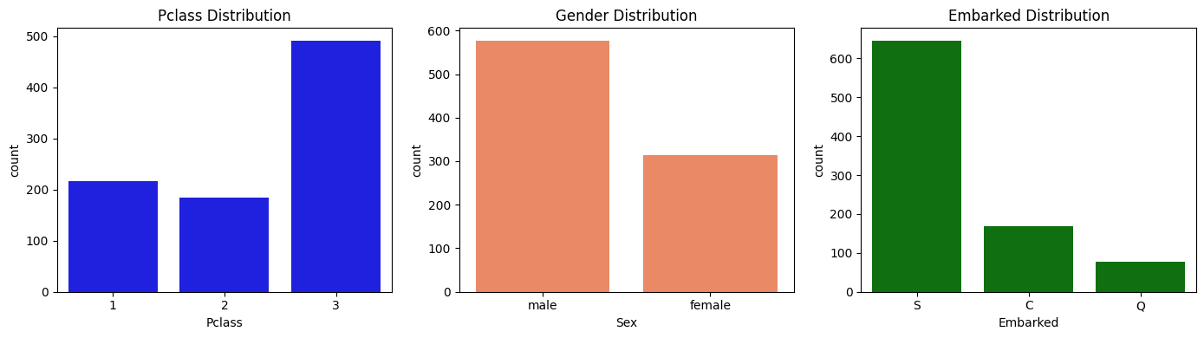
DISTRIBUTION FOR CATEGORICAL COLUMN
The majority of passengers are in the third class (Pclass 3)
Male passengers are more dominant compared to female passengers.
Most passengers embarked from the port of Southampton (S)

Slide 12
EXPLORATORY DATA ANALYSIS (BIVARIATE ANALYSIS)

Slide 13
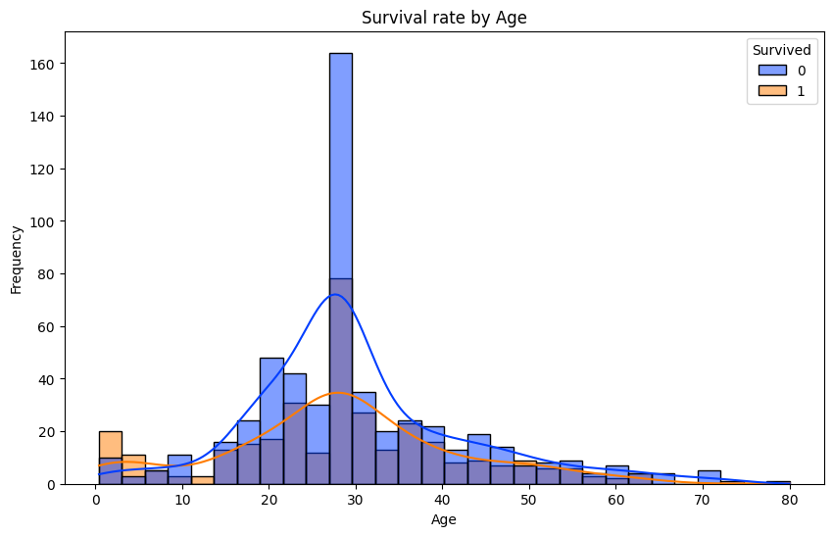
Question 1:
Does the age of passengers affect their chances of survival?
Age significantly influenced survival chances on the Titanic. Children under 10 years have a better chance of surviving, perhaps because they are prioritized for rescue using lifeboats. While older passengers faced lower survival chances.

Slide 14
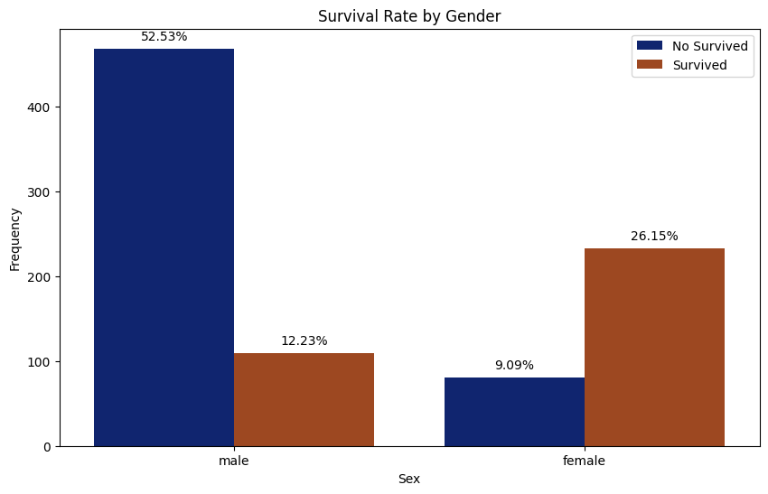
Question 2:
Does gender have a significant impact on survival rates?
Gender significantly influenced survival on the Titanic. Females had a much higher survival rate compared to males. This indicates that female passengers were given priority for survival.

Slide 15
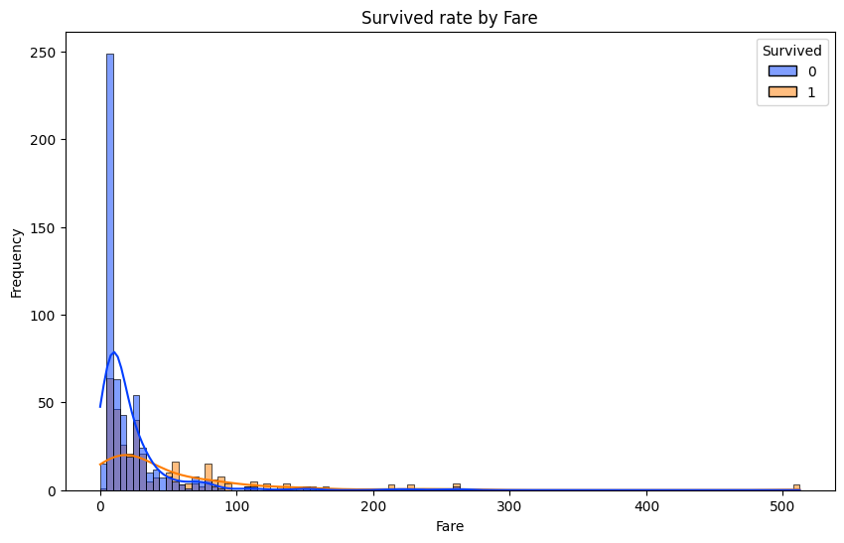
Question 3:
Does the fare paid affect survival rate?
Passengers with high fares have a better chance of surviving than those with low fares.

Slide 16
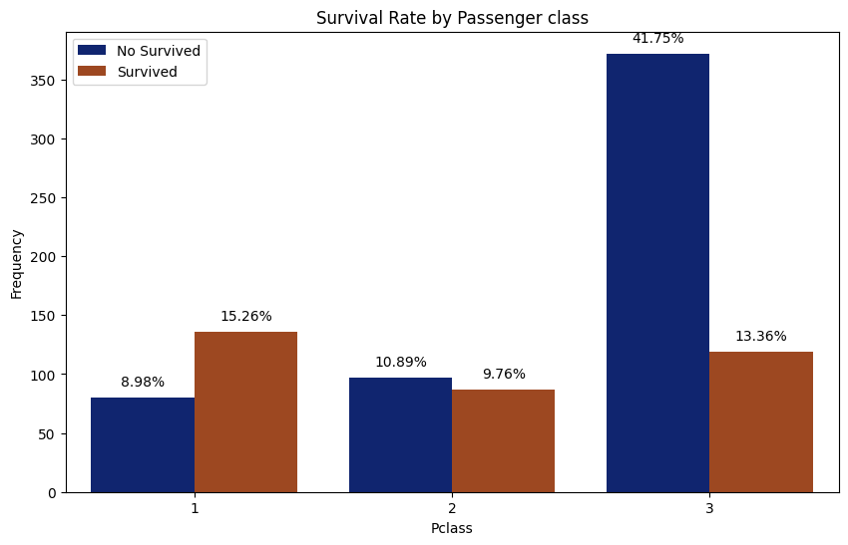
Question 4:
Which passenger classes had the highest survival rates?
Passengers in First Class had the highest survival rate. This suggests that First Class passengers had priority access to lifeboats or other rescue measures.

Slide 17
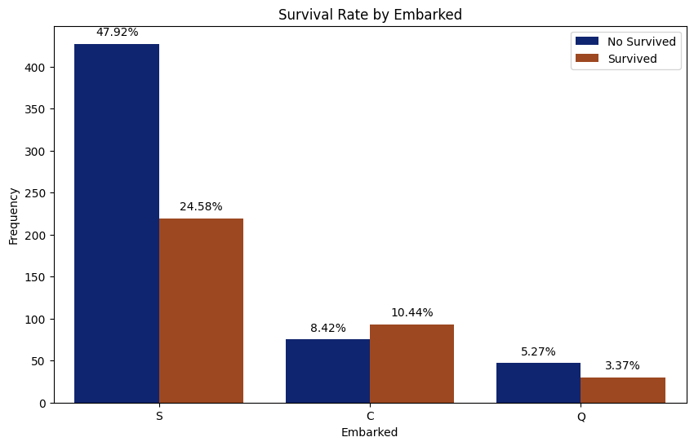
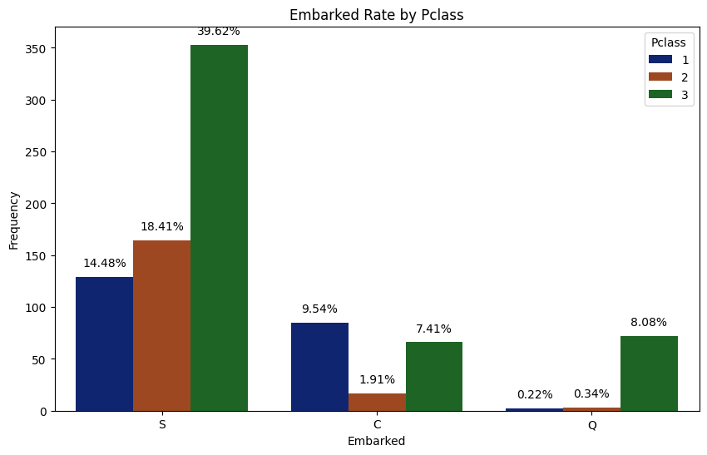
Question 5:
Does Port of Embarkation affect Survival rate?
The highest survival rate was observed among passengers who embarked from Cherbourg (C). This suggests that passengers who embarked from Cherbourg were predominantly first class passengers (Pclass = 1).

Slide 18
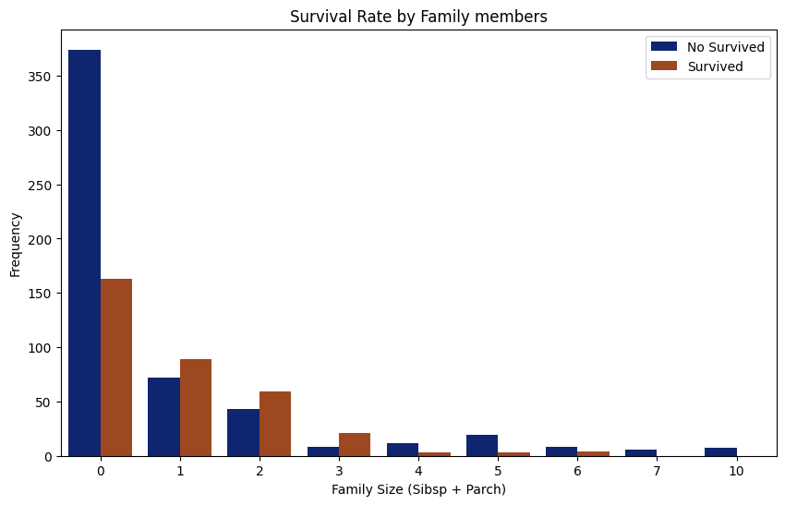
Question 6:
How does the number of family members aboard the Titanic (SibSp and Parch) influence a passenger's likelihood of survival?
Overall, the graph shows that the number of family members had an influence on the survival rate of Titanic passengers. Having one to three family members tends to increase the chances of survival, but having too many family members can actually decrease those chances.

Slide 19
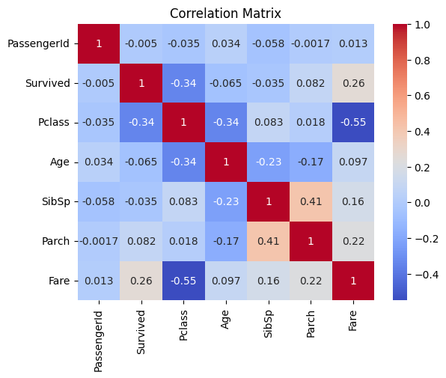
CORRELATION MATRIX
Pclass and Fare have a negative correlation; the lower the Pclass, the higher the Fare.
The most influential feature on Survived is Pclass.

Slide 20
DATA PREPROCESSING

Slide 21
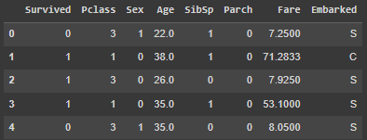
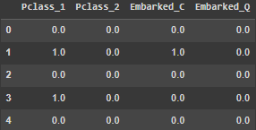
LABEL ENCODING AND ONE HOT ENCODING
Label Encoding
One Hot Encoding
All columns have been converted to numeric, and we also removed the last column in Pclass, and Embarked because failing to do so would result in a very high Variance Inflation Factor (VIF).

Slide 22
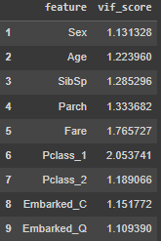
MULTICOLINEARITY HANDLING
The Variance Inflation Factor was calculated for each predictor variable. A high VIF indicates high multicollinearity.
Variables with high VIF values (typically VIF > 10) were evaluated for potential removal. Redundant features that contributed to high multicollinearity were either removed or combined to reduce multicollinearity.

Slide 23
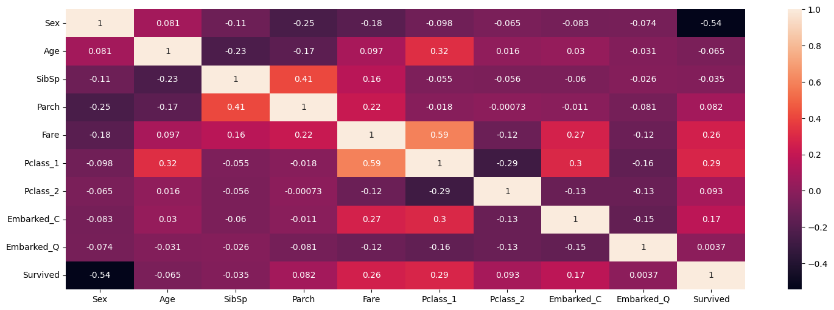
MULTICOLINEARITY HANDLING
It appears that there are no variables with strong correlations, indicating good VIF values and effectively addressed multicollinearity issues.

Slide 24
MODEL BUILDING

Slide 25
XGBoost
Model
(without and with SMOTE)
Logistic
Regression
Random Forest

Slide 26
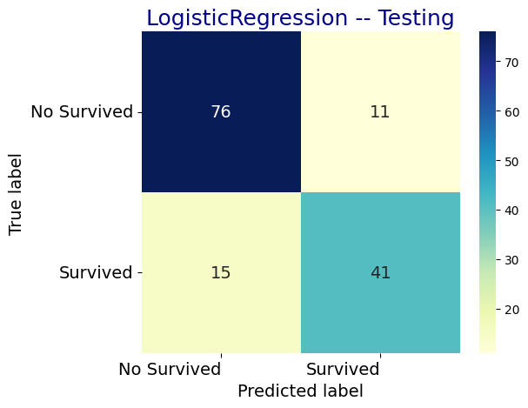
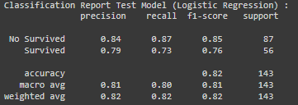
Without SMOTE:
Logistic Regression
Confusion Matrix
Best Parameters for Logistic Regression: {'C': 0.1, 'max_iter': 100, 'penalty': 'l2', 'solver': 'newton-cg'}

Slide 27

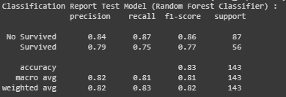
Without SMOTE:
Random Forest
Confusion Matrix
Best Parameters for Random Forest Classifier: {'max_depth': 10, 'n_estimators': 100}

Slide 28
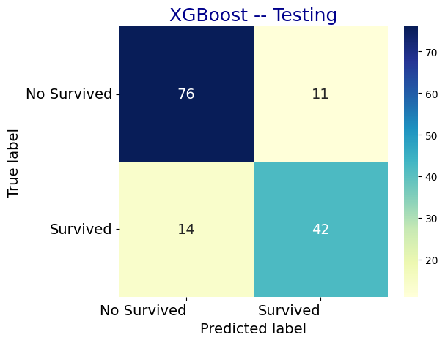
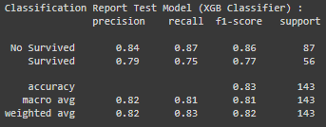
Without SMOTE:
XGBoost
Confusion Matrix
Best Parameters for XGB Classifier: {'gamma': 0.1, 'learning_rate': 0.01, 'max_depth': 3, 'n_estimators': 200}

Slide 29
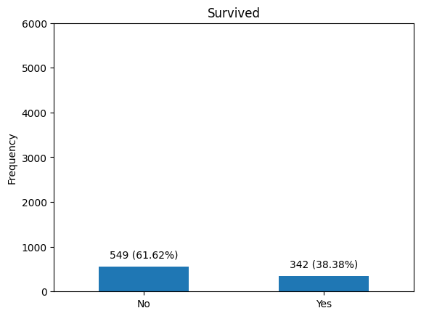
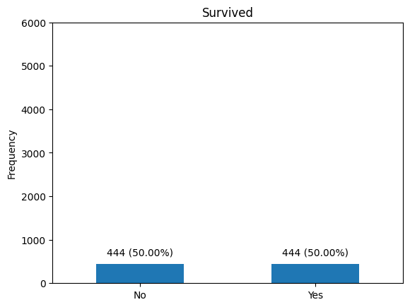
IMBALANCE HANDLING
Before SMOTE
After SMOTE

Slide 30
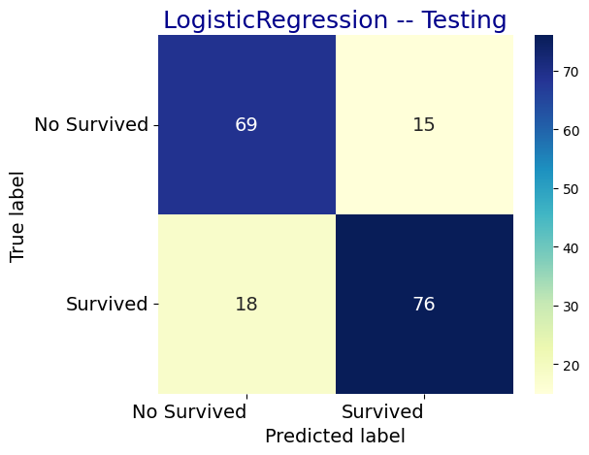
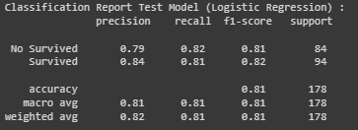
With SMOTE:
Logistic Regression
Confusion Matrix
Best Parameters for Logistic Regression: {'C': 0.01, 'max_iter': 200, 'penalty': 'none', 'solver': 'lbfgs'}

Slide 31
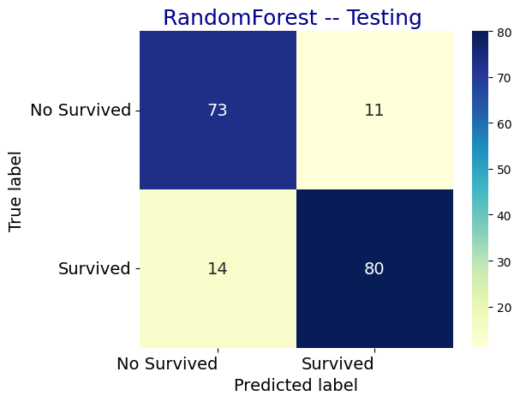
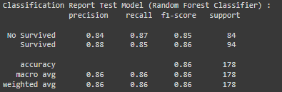
With SMOTE:
Random Forest
Confusion Matrix
Best Parameters for Random Forest Classifier: {'max_depth': 10, 'n_estimators': 100}

Slide 32
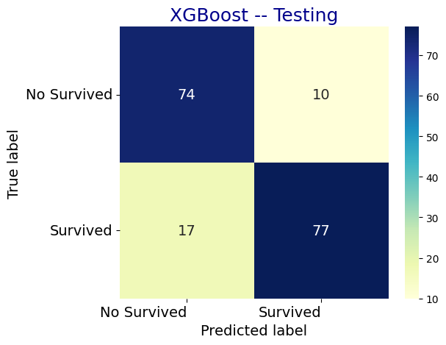
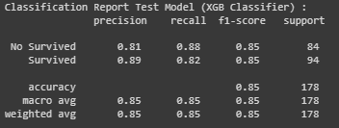
With SMOTE:
XGBoost
Confusion Matrix
Best Parameters for XGB Classifier: {'gamma': 0, 'learning_rate': 0.2, 'max_depth': 3, 'n_estimators': 200}

Slide 33
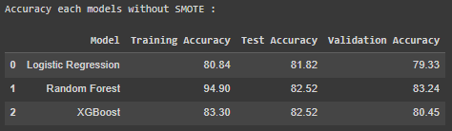
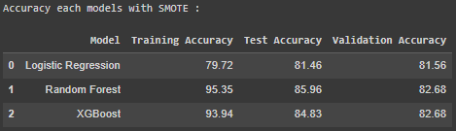
FINDING THE BEST MODEL

Slide 34

CONCLUSION
The best algorithm for titanic survival prediction is Random Forest with SMOTE. It achieved a high test accuracy of 85.96% and validation accuracy of 82.68%.
In predicting survival, where the focus is on identifying those who survived, Random Forest with SMOTE offers a precision of 0.88, which is slightly lower than XGBoost with SMOTE at 0.89. However, it stands out with a higher recall of 0.85, compared to XGBoost's 0.82. This higher recall is particularly important because it means the model is better at correctly identifying those who survived, thereby reducing the chances of missing true positive cases and minimizing false negatives. Overall, Random Forest with SMOTE combines high accuracy, improved recall, and stability, making it the most reliable choice for survival prediction.

Slide 35

THANK YOU!

